Slide 1

K. Praveen Kumar
Asst. Professor
GITAM University

Slide 2

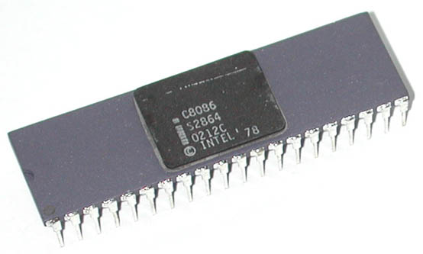
Intel 8086 was launched in 1978.
It was the first 16-bit microprocessor.
This microprocessor had major improvement over the execution speed of 8085.
It is available as 40-pin Dual-Inline-Package (DIP).

Slide 3
It is available in three versions:
  8086 (5 MHz)
  8086-2 (8 MHz)
  8086-1 (10 MHz)
It consists of 29,000 transistors.

Slide 4
It has a 16 line data bus.
And 20 line address bus.
It could address up to 1 MB of memory.
It has more than 20,000 instructions.
It supports multiplication and division.

Slide 5

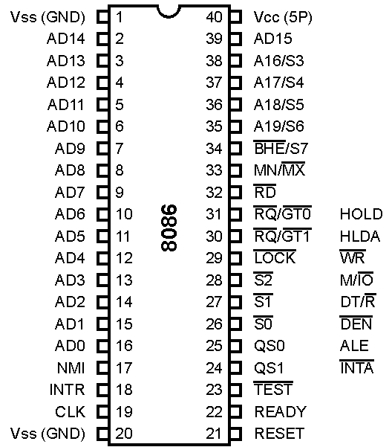

Slide 6

These lines are multiplexed bi-directional address/data bus.
During T₁, they carry lower order 16-bit address.
In the remaining clock cycles, they carry 16-bit data.
AD₀-AD₇ carry lower order byte of data.
AD₈-AD₁₅ carry higher order byte of data.

Slide 7

These lines are multiplexed unidirectional address and status bus.
During T₁, they carry higher order 4-bit address.
In the remaining clock cycles, they carry status signals.

Slide 8

S5-status of the interrupt enable flag is updated
S4, S3- Indicates which segment is presently being used for memory
S6- always low
S4 | S3 | Indication
0 | 0 | Alternate Data
0 | 1 | Stack
1 | 0 | Code or None
1 | 1 | Data

Slide 9

BHE stands for Bus High Enable.
BHE signal is used to indicate the transfer of data over higher order data bus (D₈ – D₁₅).
8-bit I/O devices use this signal.
It is multiplexed with status pin S₇.

Slide 10

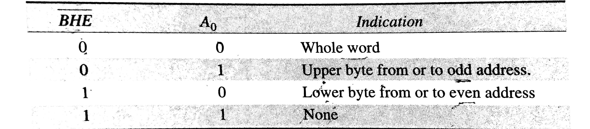

Slide 11

It is a read signal used for read operation.
It is an output signal.
It is an active low signal.

Slide 12

This is an acknowledgement signal from slower I/O devices or memory.
It is an active high signal.
When high, it indicates that the device is ready to transfer data.
When low, then microprocessor is in wait state.

Slide 13

It is a system reset.
It is an active high signal.
When high, microprocessor enters into reset state and terminates the current activity.
It must be active for at least four clock cycles to reset the microprocessor.

Slide 14

It is an interrupt request signal.
It is active high.
It is level triggered.

Slide 15

It is a non-maskable interrupt signal.
It is an active high.
It is an edge triggered interrupt.

Slide 16

This input is examined by a WAIT instruction.
If low, execution continues else microprocessor is in wait state.

Slide 17

This clock input provides the basic timing for processor operation.
It is asymmetric square wave with 33% duty cycle.
The range of frequency of different versions is 5 MHz, 8 MHz and 10 MHz.

Slide 18

V_{CC} is power supply signal.
+5V DC is supplied through this pin.
V_{SS} is ground signal.

Slide 19

8086 works in two modes:
  Minimum Mode
  Maximum Mode
If MN/MX is high, it works in minimum mode.
If MN/MX is low, it works in maximum mode.

Slide 20
Pins 24 to 31 issue two different sets of signals.
One set of signals is issued when CPU operates in minimum mode.
Other set of signals is issued when CPU operates in maximum mode.

Slide 21


Slide 22

This is an interrupt acknowledge signal.
When microprocessor receives INTR signal, it acknowledges the interrupt by generating this signal.
It is an active low signal.

Slide 23

This is an Address Latch Enable signal.
It indicates that valid address is available on bus AD₀ – AD₁₅.
It is an active high signal and remains high during T₁ state.
It is connected to enable pin of latch 8282.

Slide 24
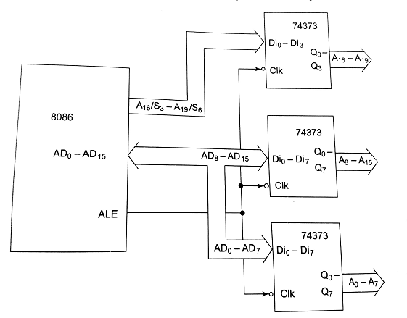

Slide 25

This is a Data Enable signal.
This signal is used to enable the transceiver 8286.
Transceiver is used to separate the data from the address/data bus.
It is an active low signal.

Slide 26

This is a Data Transmit/Receive signal.
It decides the direction of data flow through the transceiver.
When it is high, data is transmitted out.
When it is low, data is received in.

Slide 27

This signal is issued by the microprocessor to distinguish memory access from I/O access.
When it is high, memory is accessed.
When it is low, I/O devices are accessed.

Slide 28
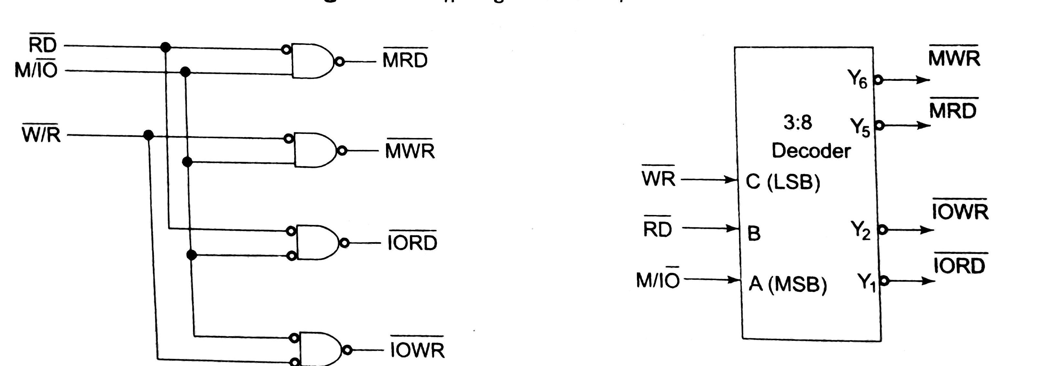

Slide 29

It is a Write signal.
It is used to write data in memory or output device depending on the status of M/IO signal.
It is an active low signal.

Slide 30

It is a Hold Acknowledge signal.
It is issued after receiving the HOLD signal.
It is an active high signal.

Slide 31

When DMA controller needs to use address/data bus, it sends a request to the CPU through this pin.
It is an active high signal.
When microprocessor receives HOLD signal, it issues HLDA signal to the DMA controller.

Slide 32


Slide 33

These pins provide the status of instruction queue.
QS₁ | QS₀ | Status
0 | 0 | No operation
0 | 1 | 1st byte of opcode from queue
1 | 0 | Empty queue
1 | 1 | Subsequent byte from queue

Slide 34

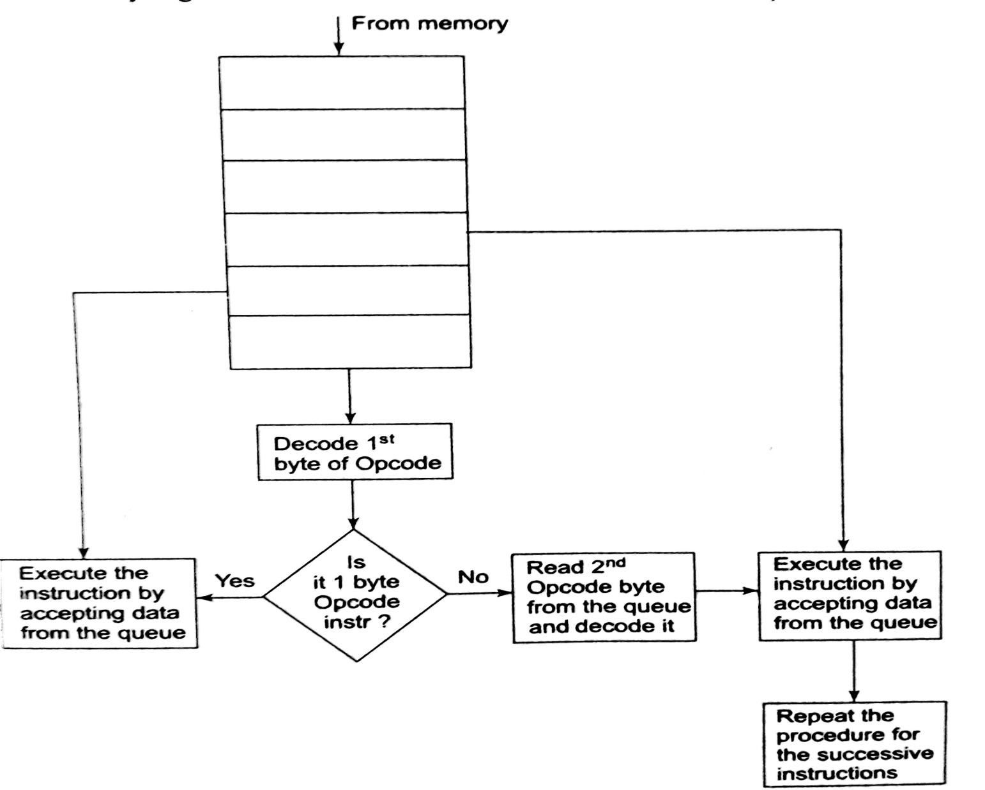

Slide 35

These status signals indicate the operation being done by the microprocessor.
This information is required by the Bus Controller 8288.
Bus controller 8288 generates all memory and I/O control signals.

Slide 36
S₂ | S₁ | S₀ | Status
0 | 0 | 0 | Interrupt Acknowledge
0 | 0 | 1 | I/O Read
0 | 1 | 0 | I/O Write
0 | 1 | 1 | Halt
1 | 0 | 0 | Opcode Fetch
1 | 0 | 1 | Memory Read
1 | 1 | 0 | Memory Write
1 | 1 | 1 | Passive

Slide 37

This signal indicates that other processors should not ask CPU to relinquish the system bus.
When it goes low, all interrupts are masked and HOLD request is not granted.
This pin is activated by using LOCK prefix on any instruction.

Slide 38

These are Request/Grant pins.
Other processors request the CPU through these lines to release the system bus.
After receiving the request, CPU sends acknowledge signal on the same lines.
RQ/GT₀ has higher priority than RQ/GT₁.

Slide 39




